Slide 1
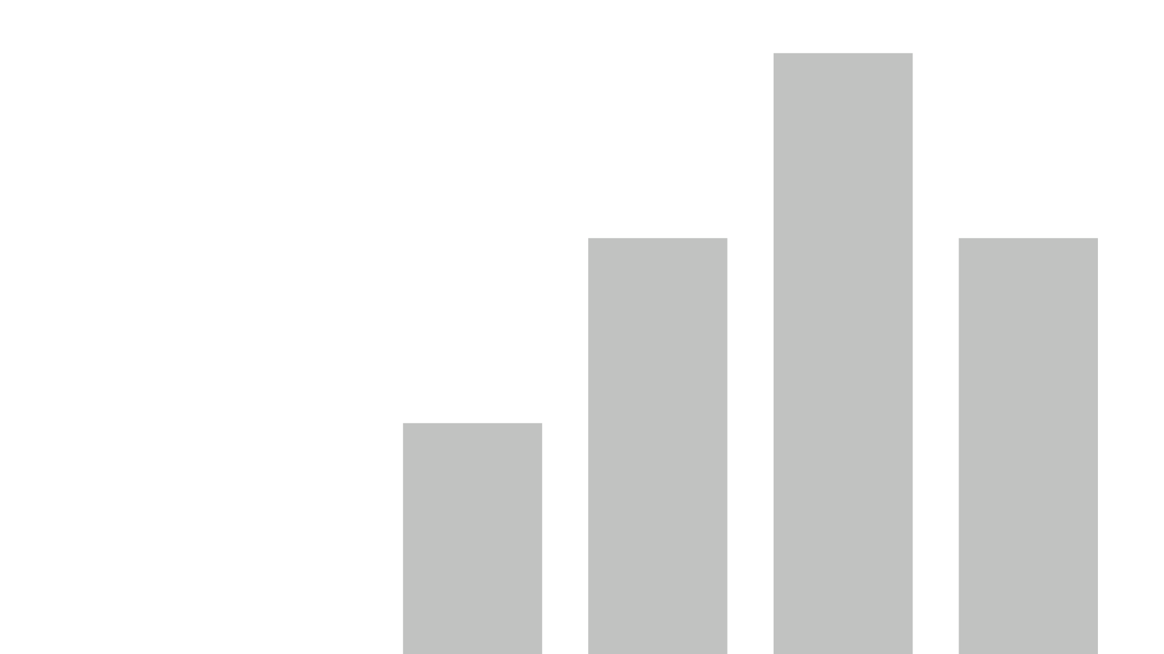

Aging Report
Summary: Designed and developed to track open tech support tickets and show how old the backlog is.
Audience: Senior leadership and tech Support teams.

Slide 2
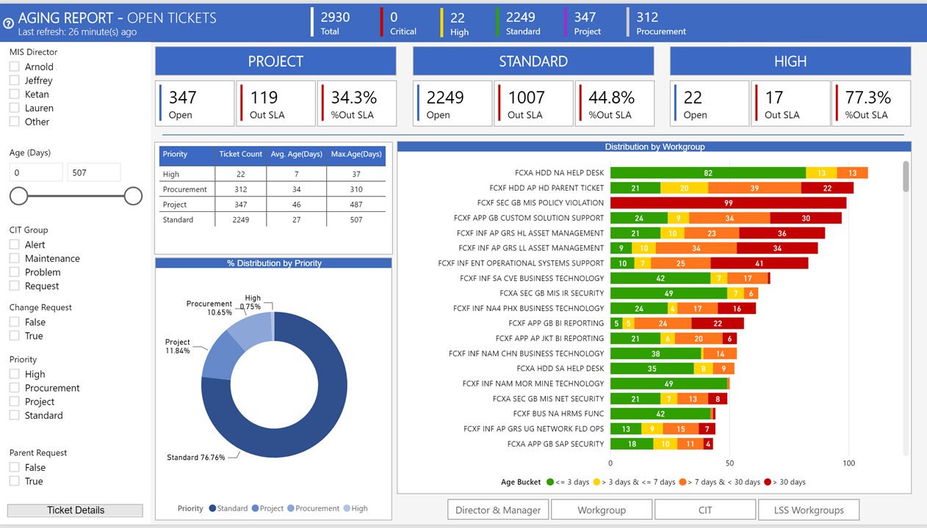

Slide 3
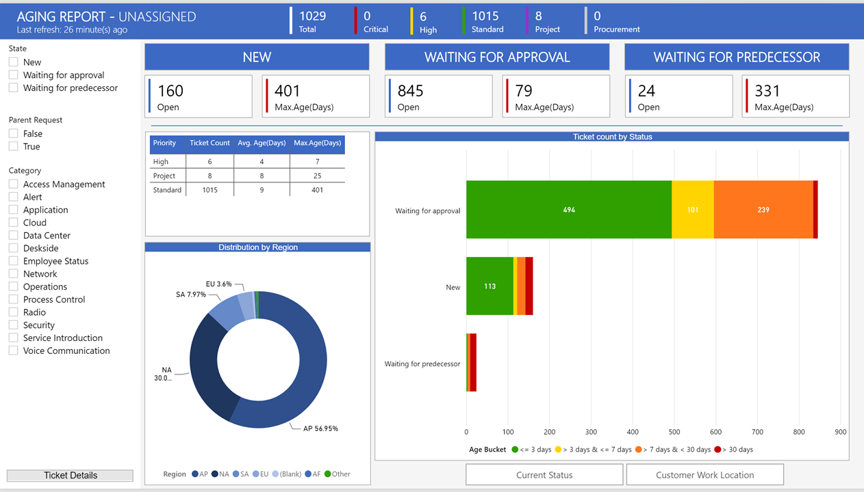

Slide 4
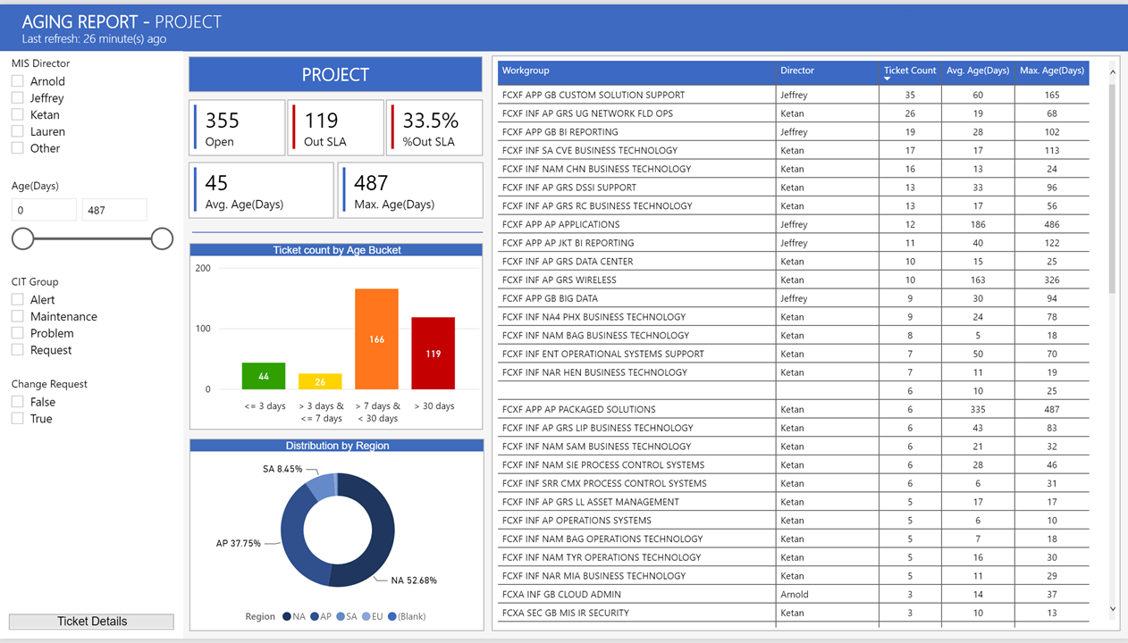

Slide 5
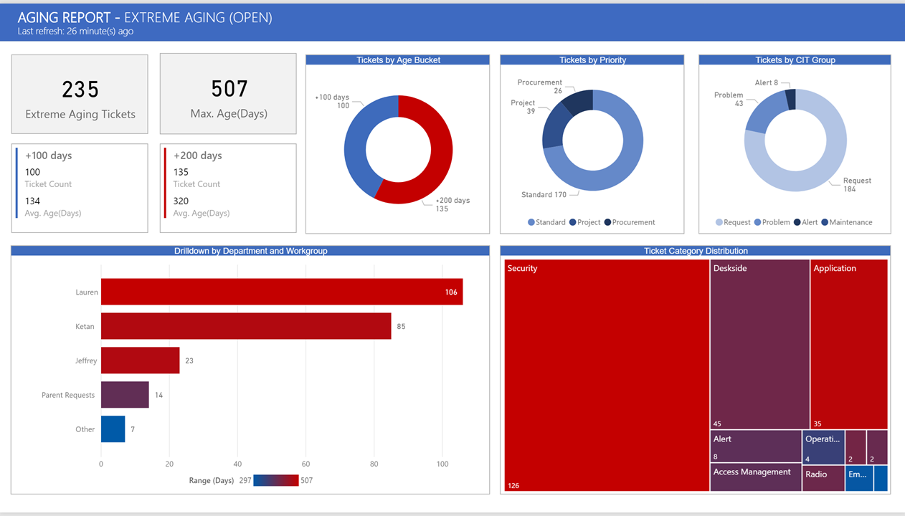

Slide 6
Approval Time Analysis
Summary: Designed and developed to track approval time in tech support tickets. Provide insights and trends by team and approver.
Audience: Senior leadership, tech Support and Service Management teams.

Slide 7
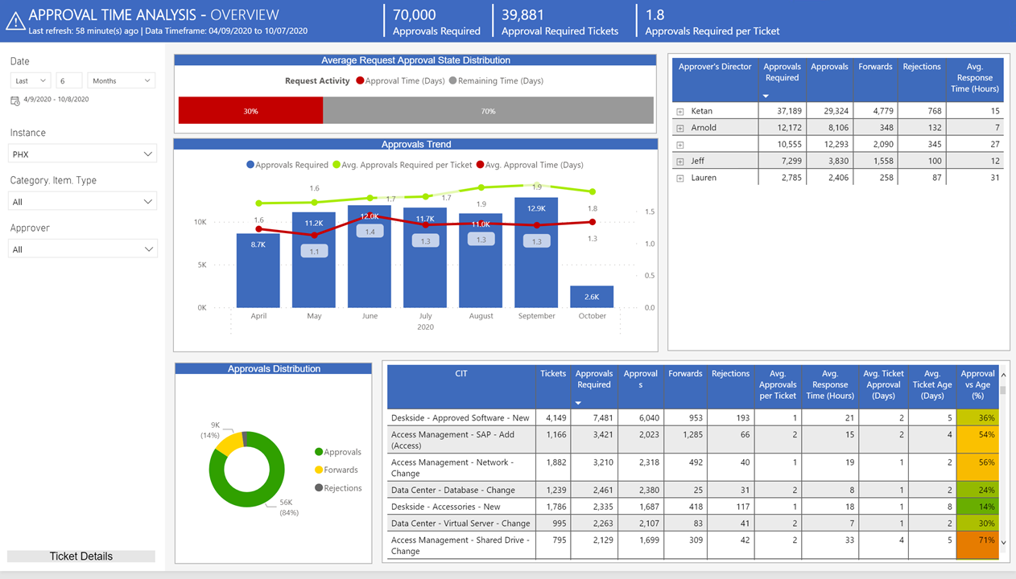

Slide 8
Capacity Report
Summary: Designed and developed to track capacity and space consumption on virtual and on-premises servers.
Audience: Infrastructure Operations teams

Slide 9
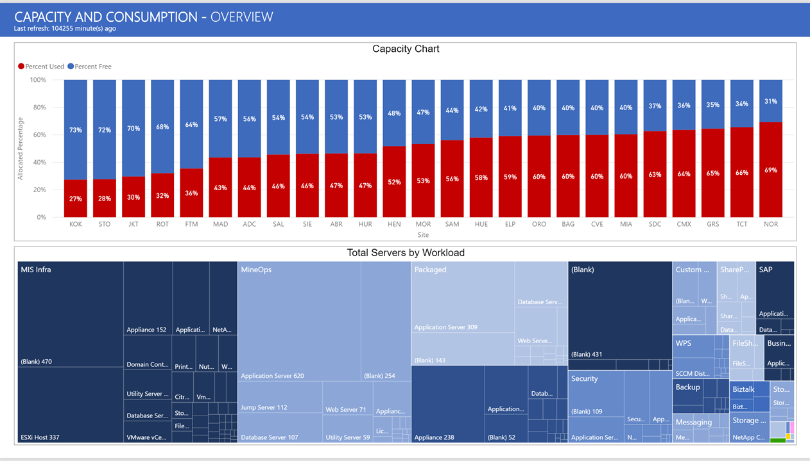

Slide 10
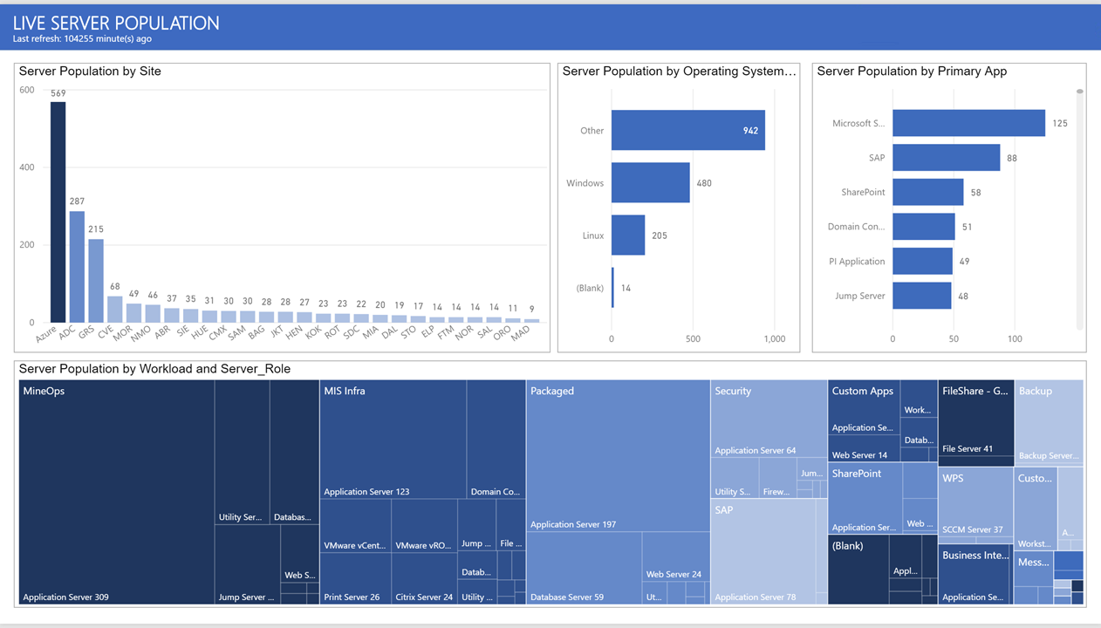

Slide 11
Change Management - Ongoing and Upcoming
Summary: Designed and developed to track open and upcoming change management requests.
Audience: Tech Support teams and Service Management.

Slide 12
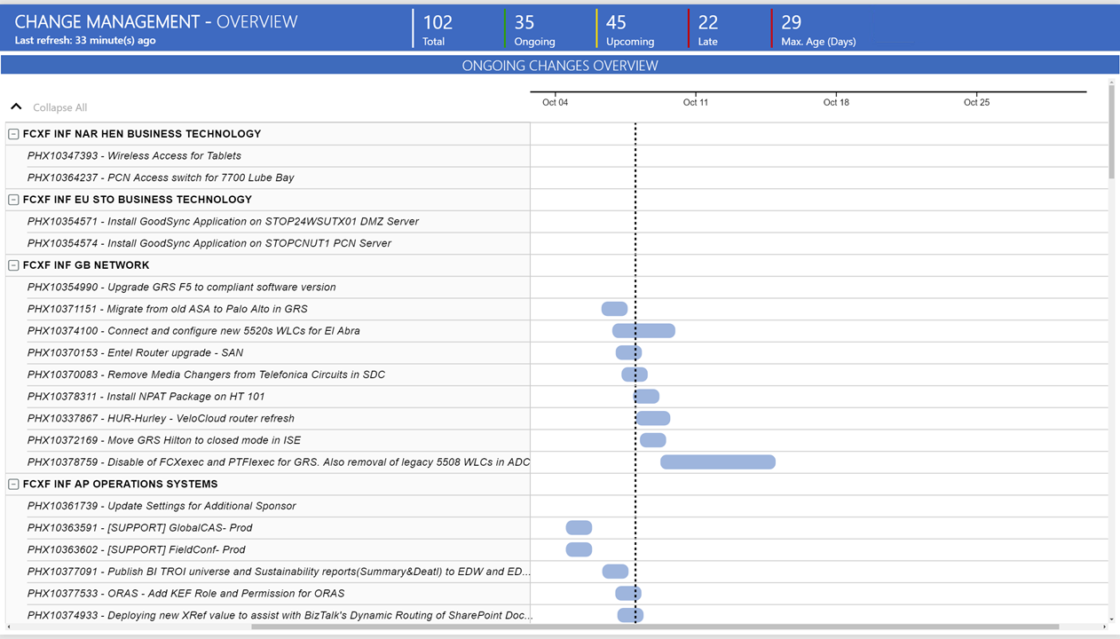

Slide 13
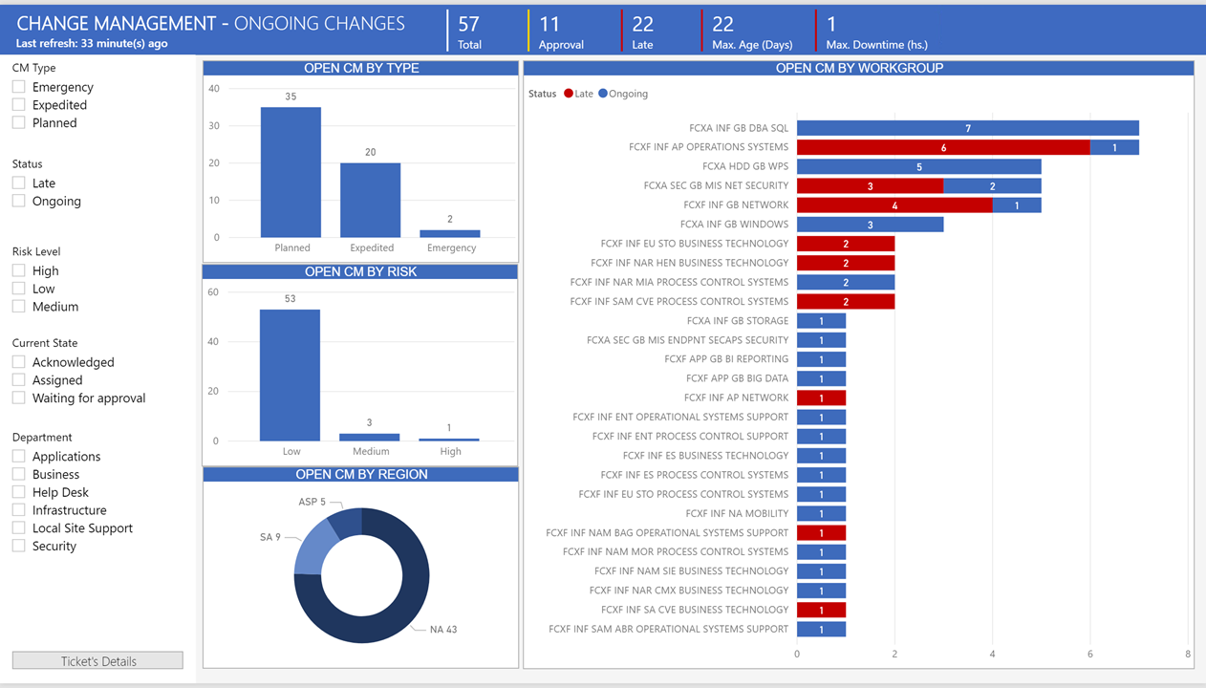

Slide 14
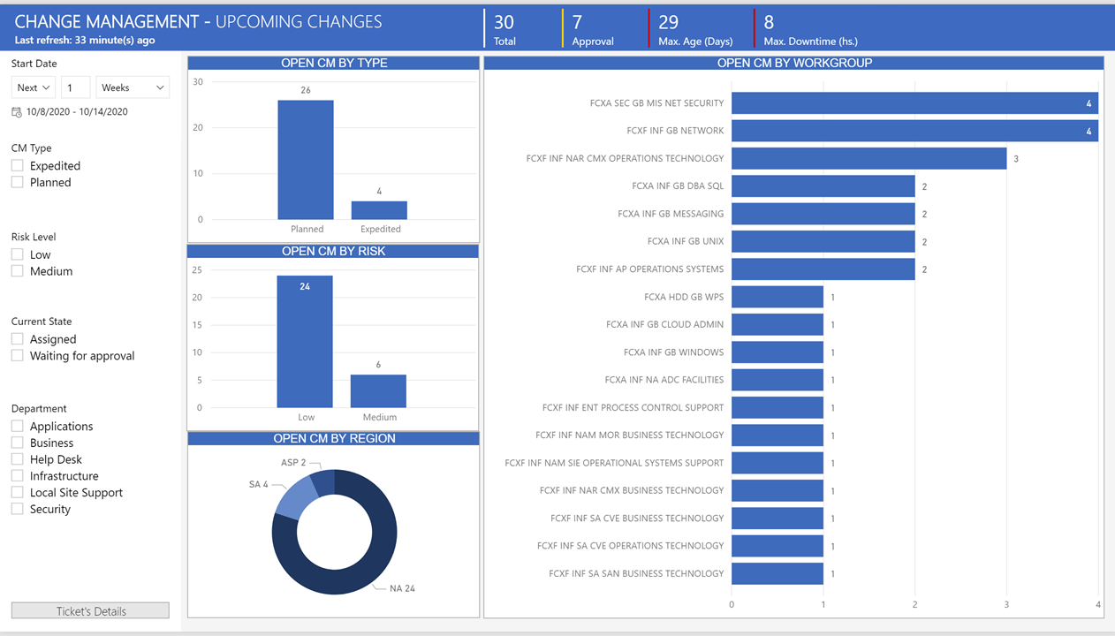

Slide 15
Change Management Report
Summary: Designed and developed to track closed change management requests. Provide insights and trends.
Audience: Senior leadership and Service Management.

Slide 16
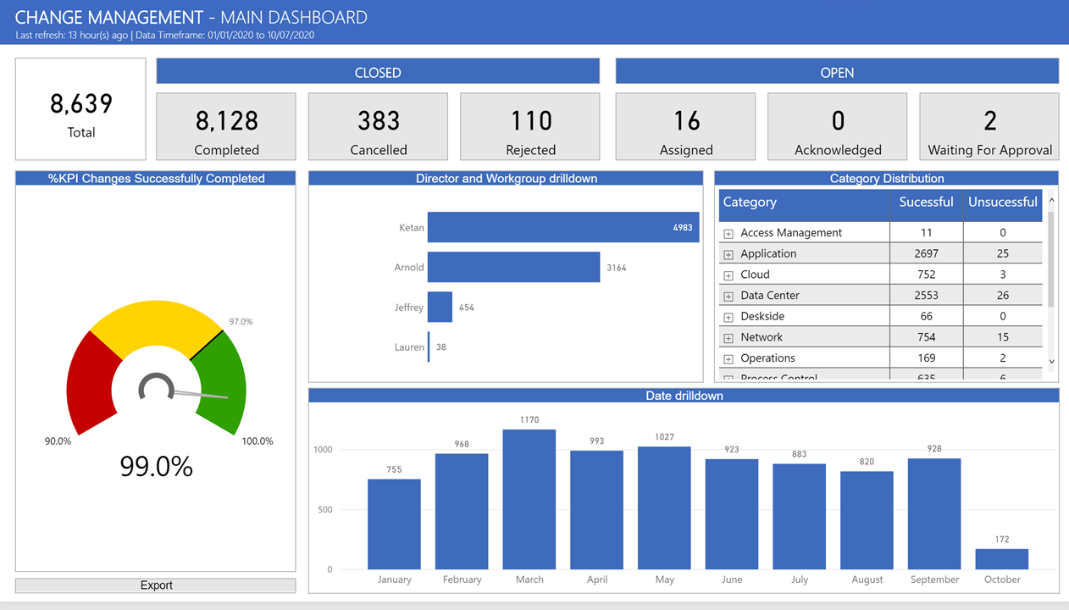

Slide 17
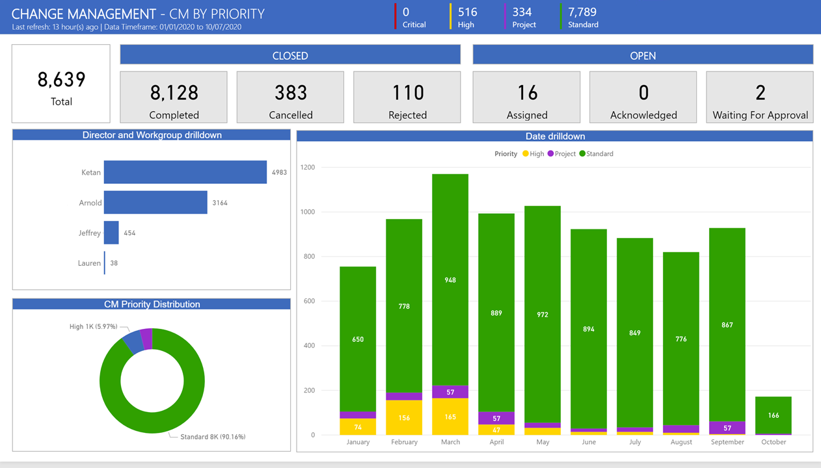

Slide 18
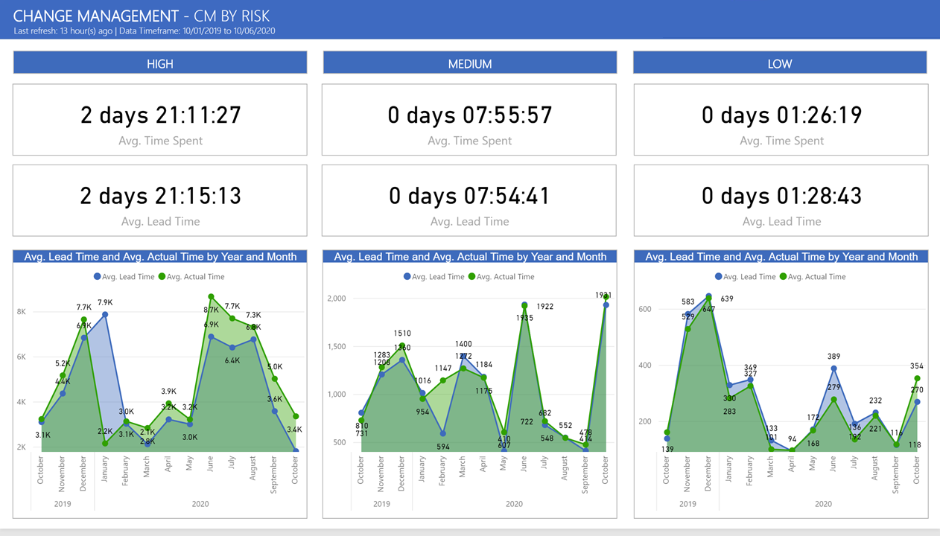

Slide 19
Escalation Report
Summary: Designed and developed to track escalations on tech support tickets: internal, by customers or auto-escalated.
Audience: Senior leadership, Tech Support teams and Service Management.

Slide 20
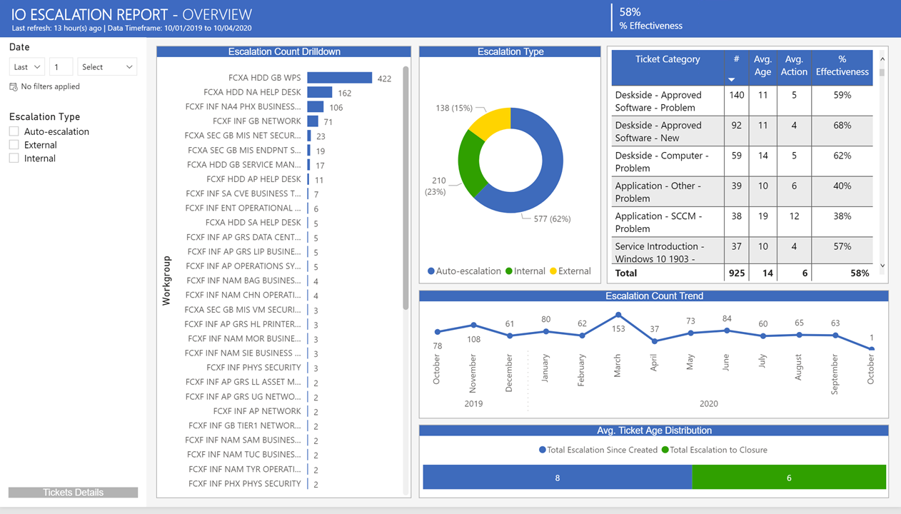

Slide 21
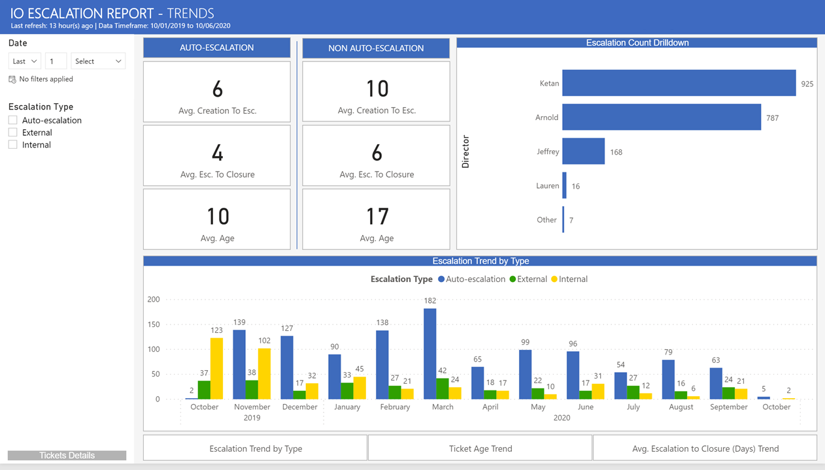

Slide 22
Executive Report
Summary: Designed and developed to showcase requests distribution globally by region and customers' support site.
Audience: Senior leadership and Directors board.

Slide 23
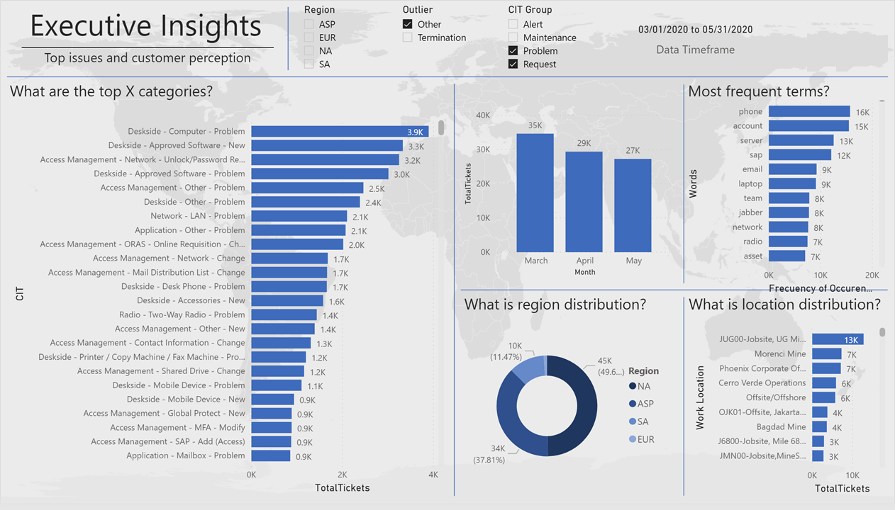

Slide 24
Incident Management
Summary: Designed and developed to track resolved outages and critical incidents which affected our client’s ecosystem. Conduct root cause analysis activity.
Audience: Senior leadership and Service Management.

Slide 25
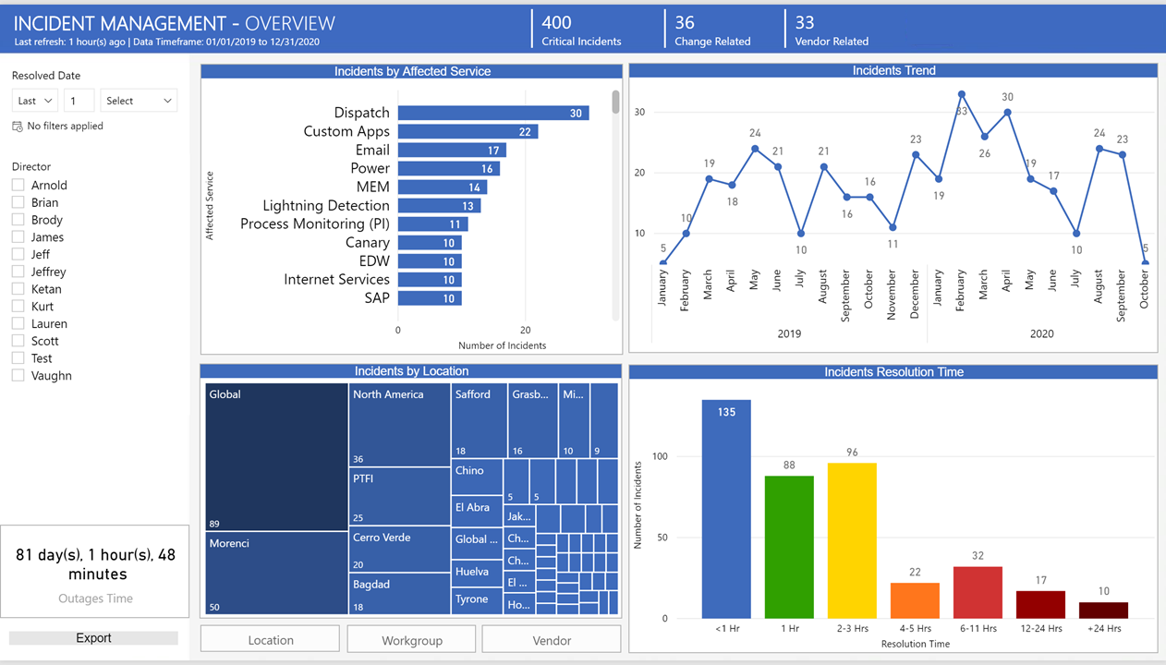

Slide 26
MIS Customer Experience
Summary: Designed and developed to showcase customer experience results based on automated surveys sent every time a support ticket resolved.
Audience: Tech support teams and Senior Directors.

Slide 27
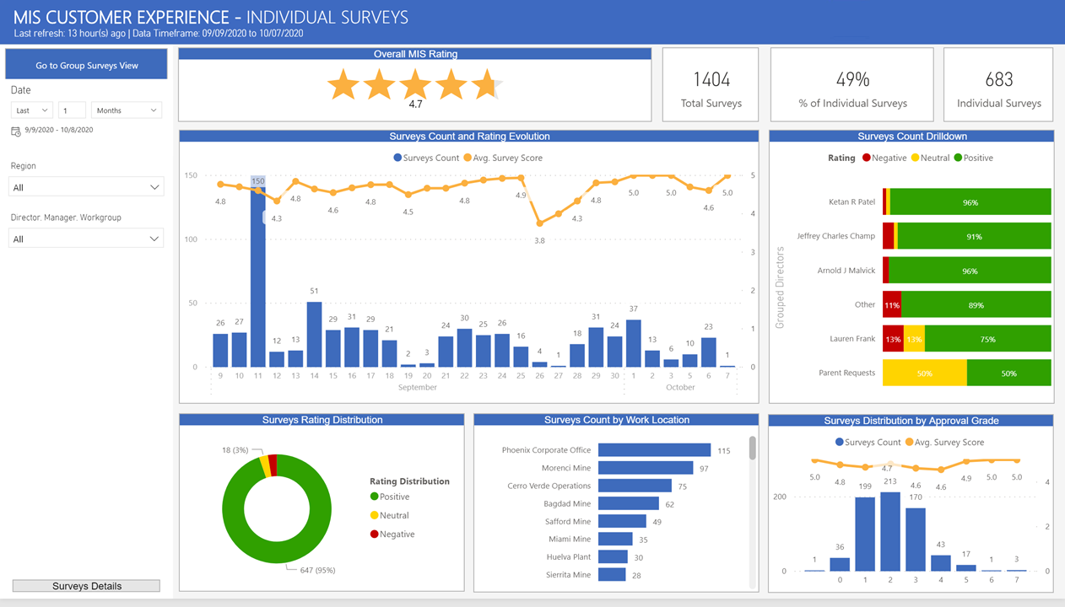

Slide 28
MIS Tower Metrics
Summary: Designed and developed to track closed support tickets.
Audience: Tech Support teams, Service Management and Directors.

Slide 29
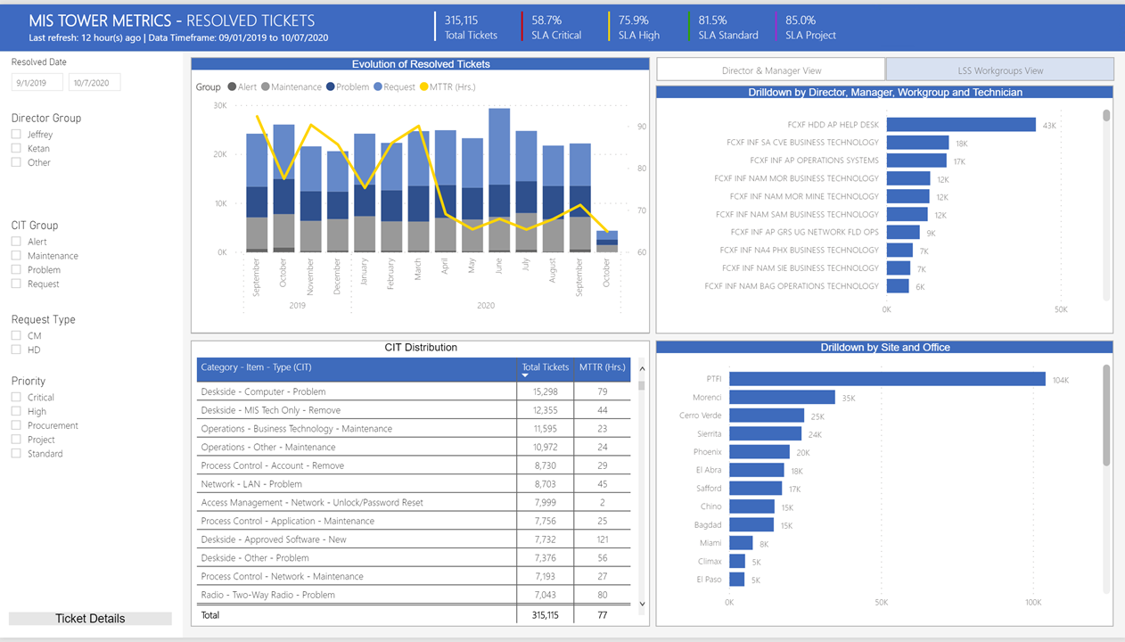

Slide 30
MOS - Server Builds
Summary: Designed and developed to showcase server builds automation using Azure templates. Trends and insights.
Audience: Tech Support teams and Senior Directors.

Slide 31
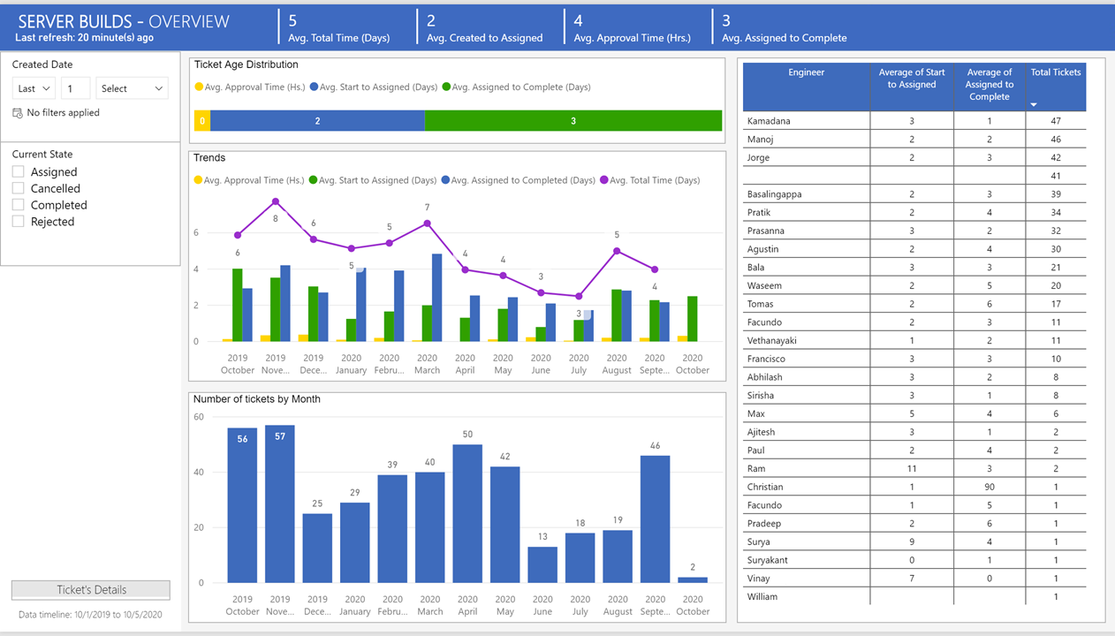

Slide 32
New Hire Analysis
Summary: Designed and developed to showcase initial requests logged by new hires to the company and provide insights to automate tasks.
Audience: Senior Directors and Service Management team.

Slide 33
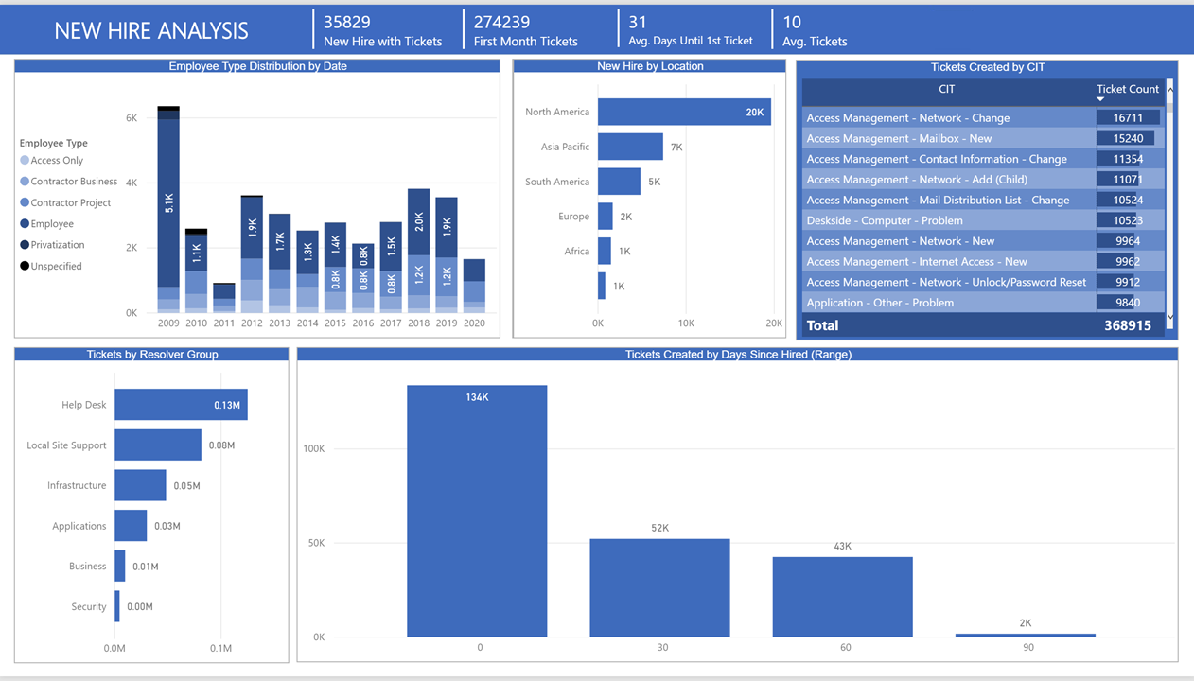

Slide 34
Software Installation
Summary: Designed and developed to showcase software installation support tickets. Find gaps and automation opportunities. Text mining technique to get text from ticket’s field.
Audience: Senior Directors and Service Management team.

Slide 35
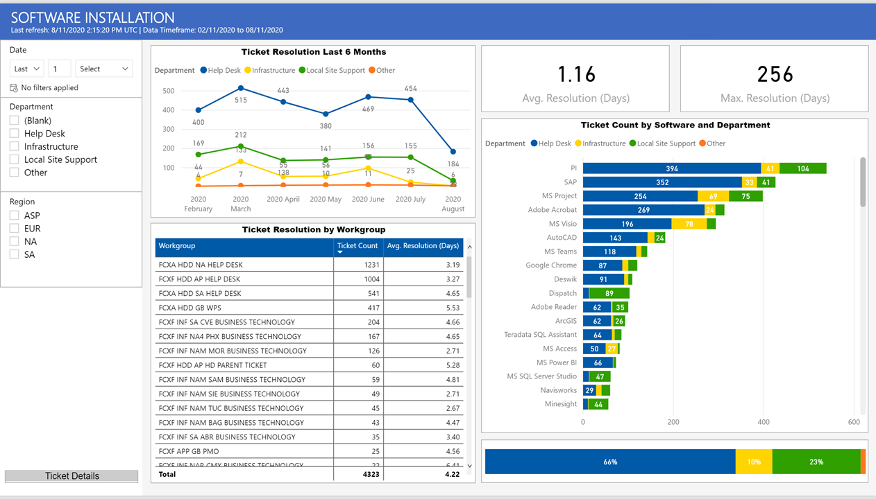

Slide 36
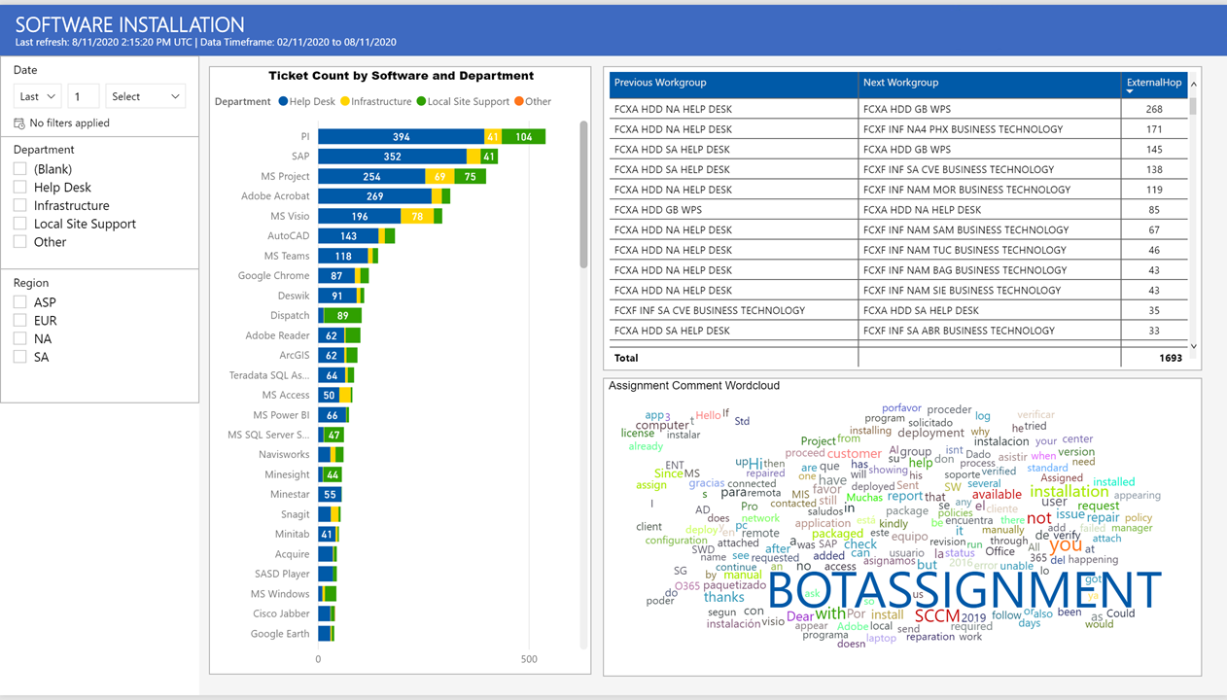

Slide 37
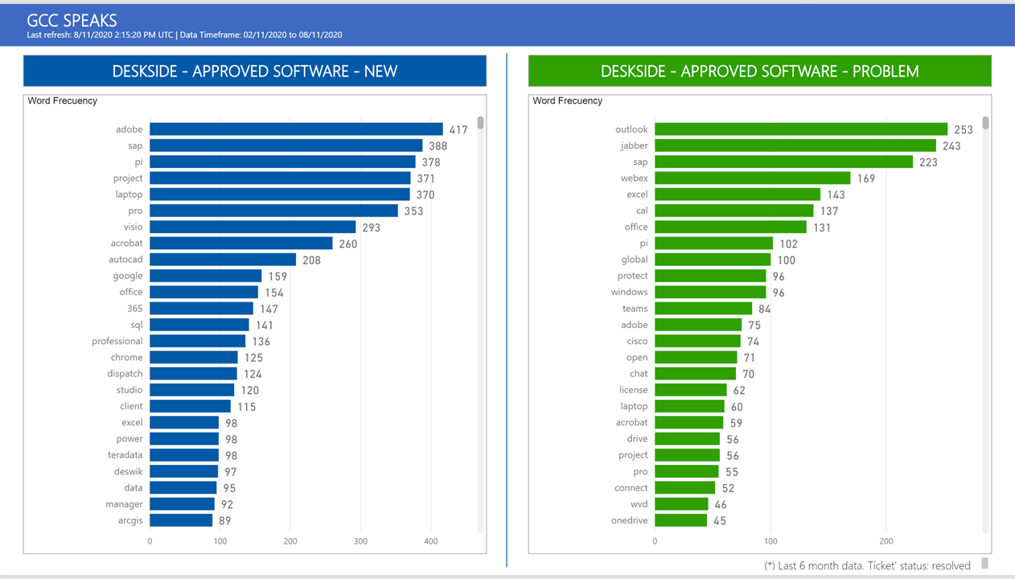

Slide 38
Variance Report
Summary: Designed and developed to showcase trends on closed support tickets. Track increase or decrease at any given time during the month and run corrective
Audience: Senior Directors and Service Management team.

Slide 39
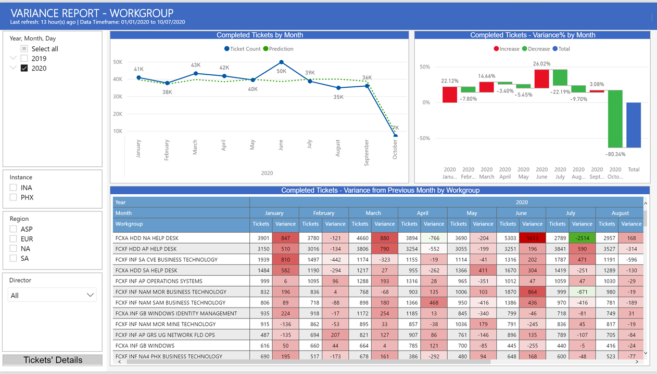

Slide 40
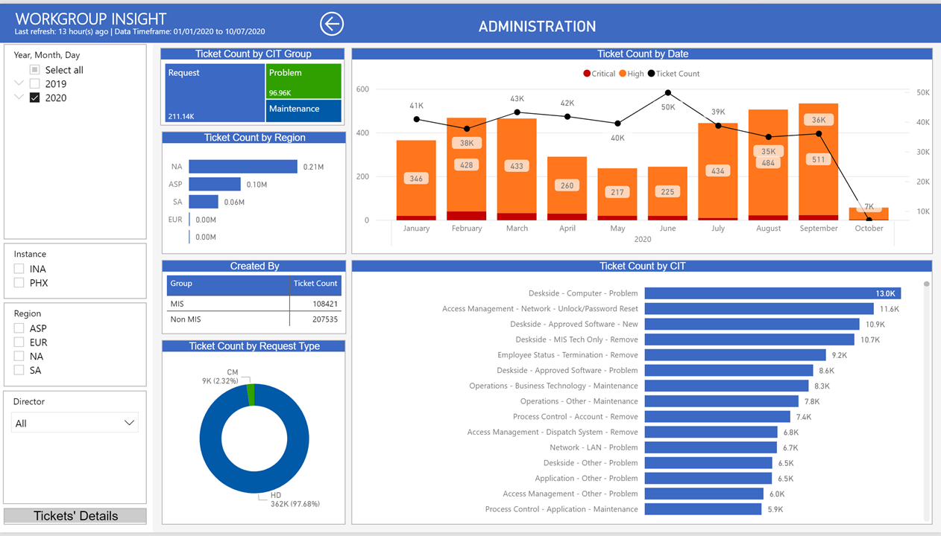

Slide 41
MOS - Server Reboot
Summary: Designed and developed to showcase server reboot activities coming from Splunk. Detect outliers, not legacy activities.
Audience: Senior Directors, Infrastructure Operations and Service Management team.

Slide 42
